Slide 1

Team FourLoop

Slide 2


Meet the Team
Lavanya Chinnam
Pujitha Balaga
Sainath Goud
Vasanthi Kodukula

Slide 3
Table of Contents
Overview
User Flow
Demo
ER Diagram
Architecture Diagram
Core Features

Slide 4
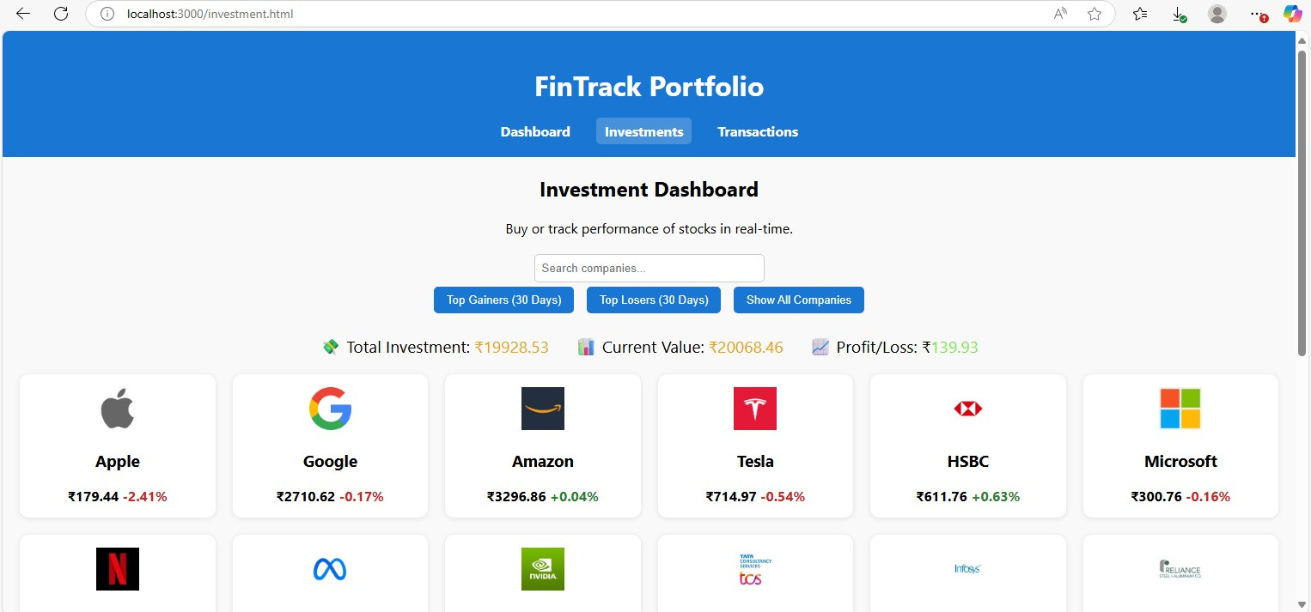
FinTrack Portfolio
A web app for tracking personal investment portfolios
Purpose
View portfolio holdings
Log buy/sell transactions
Review transaction history

Slide 5
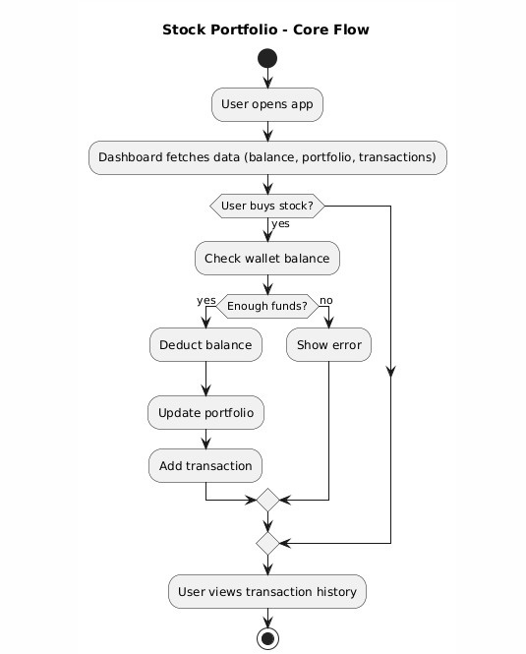
Our UserFlow

Slide 6
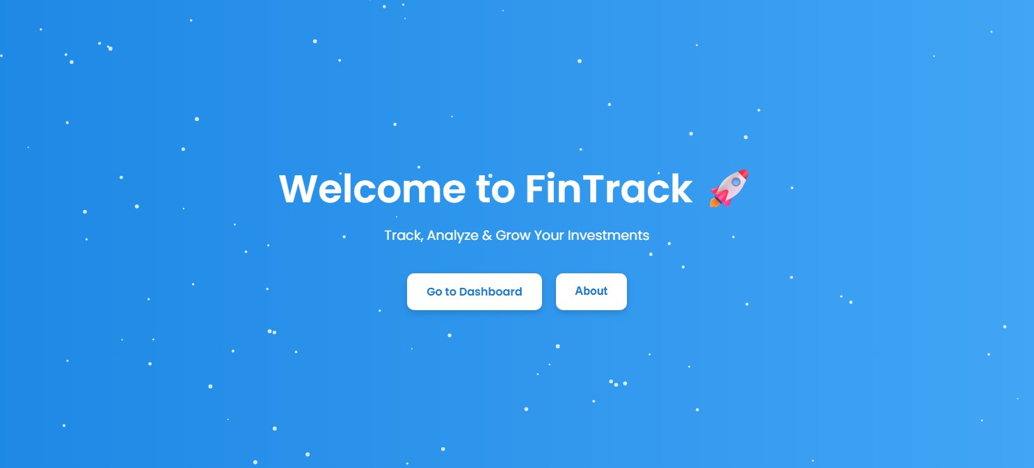
Screenshots

Slide 7
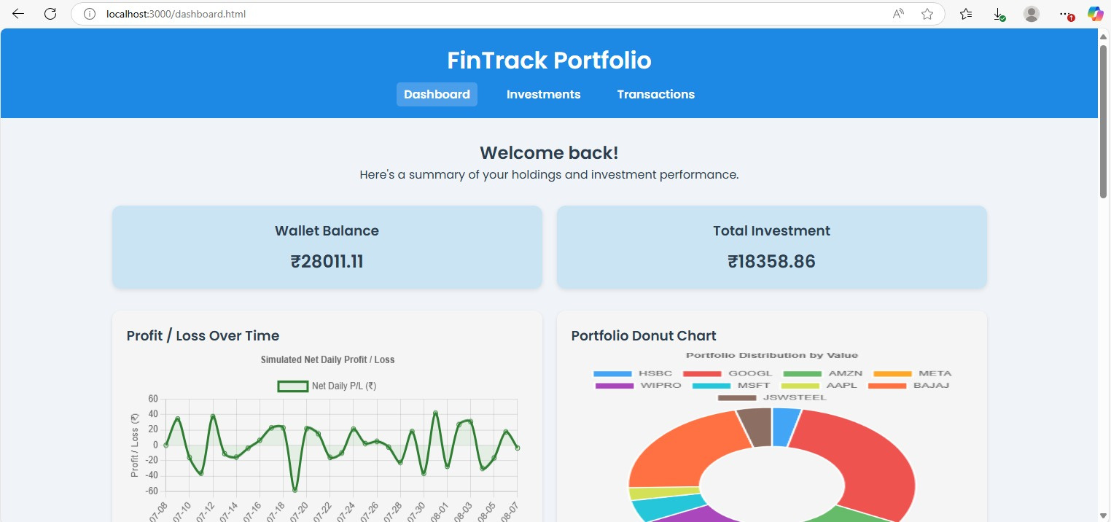
Screenshots

Slide 8

Screenshots

Slide 9
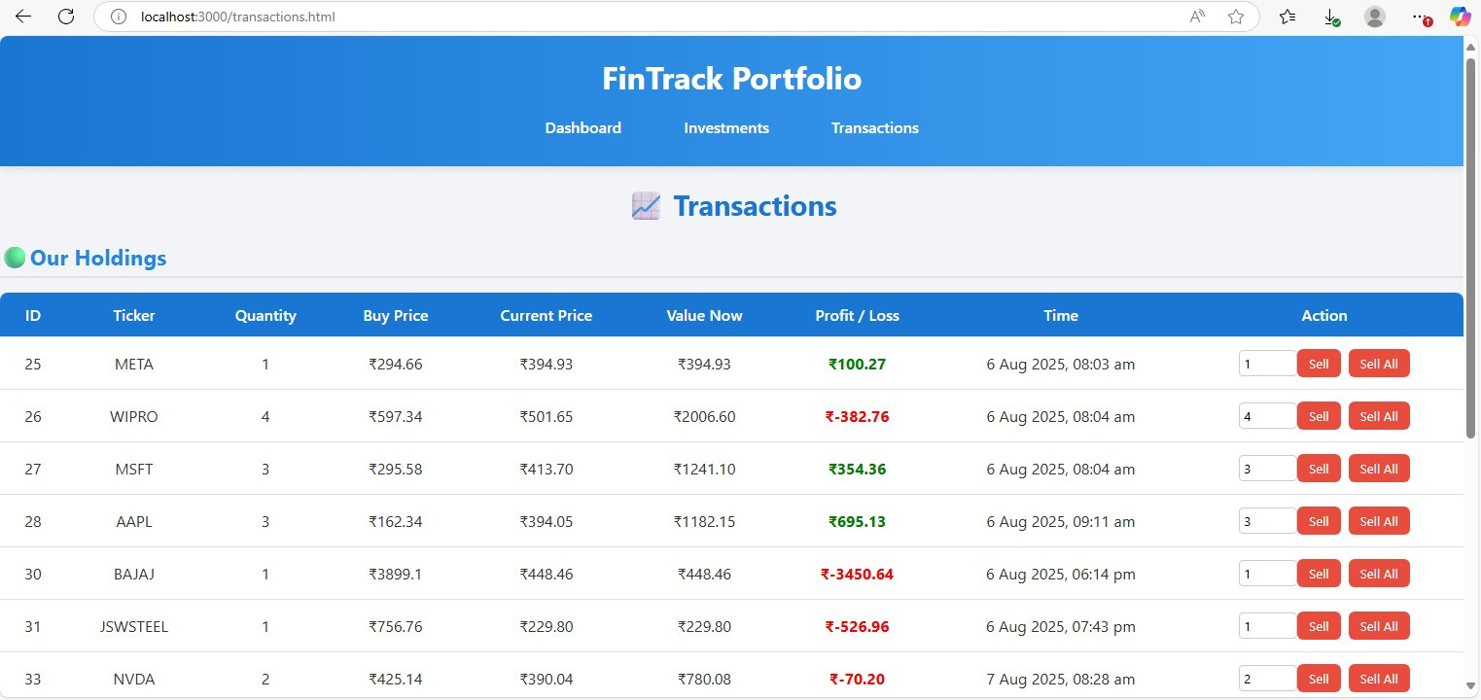
Screenshots

Slide 10

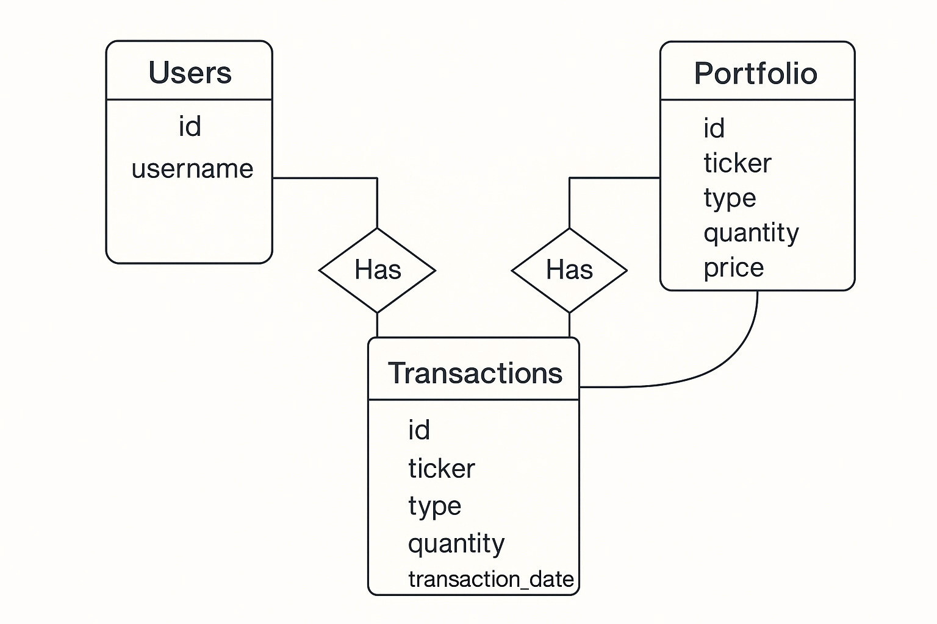


ER Diagram

Slide 11
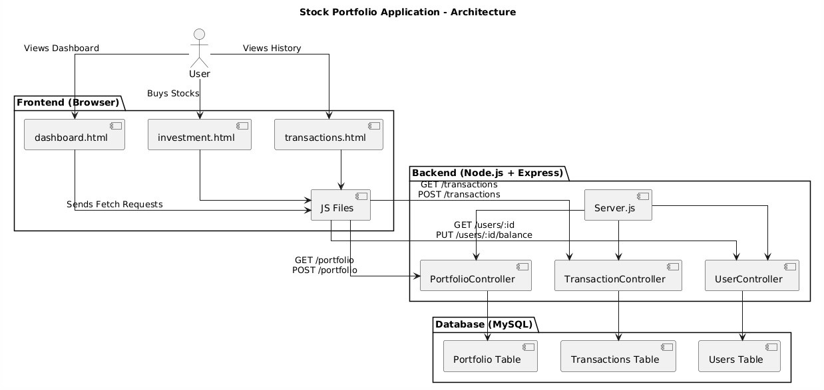
Architecture

Slide 12
Our Tech Stack
HTML
CSS, JS
EXPRESS
MySQL
GIT
GITHUB
JEST
FRONTEND
BACKEND
DATABASE
VERSION CONTROL
UNIT TESTING

Slide 13

Add, view, and manage buy/sell transactions
Core Features
View real-time portfolio holdings (based on transaction data)
Transaction history with date, stock, quantity, and price
Investments Performance

Slide 14
Thank
You!

